Slide 1
Unit VI: Recorders, Displays and Storage Devices (5hrs)
6.1 Oscilloscopes:
6.1.1 Cathode Ray Tube, Vertical and Horizontal Deflection Systems, Delay lines, Probes and Transducers,
6.1.2 Specification of an Oscilloscope
6.1.3 Oscilloscope measurement Techniques
6.2 Special Oscilloscopes – Storage Oscilloscope, Sampling Oscilloscope
6.3 Recorders Basic recording systems. Strip chart recorders. Galvanometer and Potentiometer type recorders (direct and null type)
6.4 Indicators and display Devices - Nixie, LED, LCD and seven segment and dot matrix displays.
6.5 Magnetic tape and disc recorders
6.6 Data loggers, Dot matrix and laser printers
6.7 Compact disc/Optical disc recorders

Slide 2
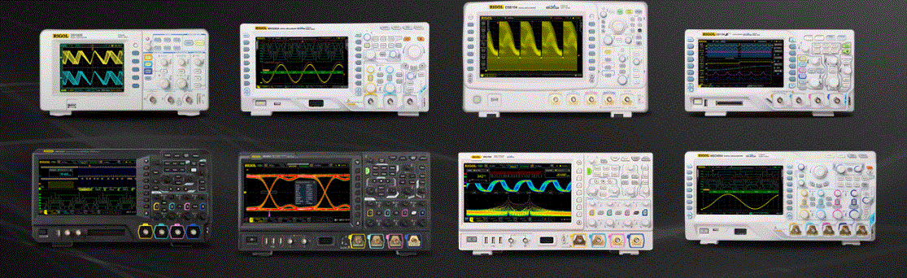
Oscilloscopes

Slide 3
Oscilloscopes
The cathode ray oscilloscope is probably the most versatile tool for the development
of electronic circuits and systems, and has been one of the more important tools in the development of modern electronics.
The cathode ray oscilloscope is a device that allows the amplitude of electrical signals, whether they be voltage, current, power, etc., to be displayed primarily as a function of time.
The oscilloscope depends on the movement of an electron beam, which is then made visible by allowing the beam to impinge on a phosphor surface, which produces a visible spot.
If the electron beam is deflected in either of two orthogonal axes, such as the familiar X and Y axes used in conventional graph construction, the luminous spot can be used to create two-dimensional displays.
Typically, the X axis of the oscilloscope is deflected at a constant rate, relative to time, and the vertical or Y axis is deflected in response to an input stimulus such as a voltage.
This produces the time-dependent variation of the input voltage, which is very important to the design and development of electronic circuits.
Time recording devices, such as pen and strip chart recorders, have existed for a long time; however, the oscilloscope is capable of much faster operation.
Rather than the recording of events over a period of a few seconds, which is typical of the mechanical-type recorder, the oscilloscope is capable of displaying events that take place over periods of microseconds and nanoseconds.

Slide 4
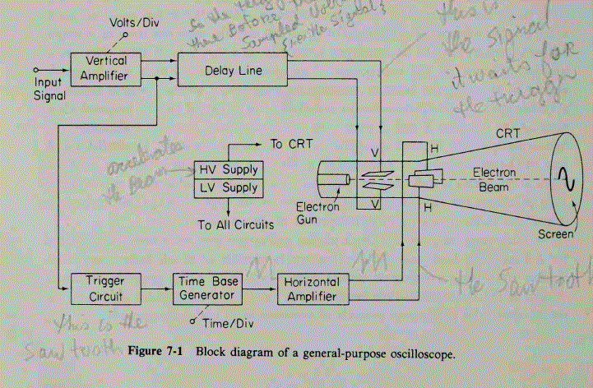
OSCILLOSCOPE BLOCK DIAGRAM

Slide 5
The heart of the oscilloscope is the cathode ray tube, which generates the electron beam, accelerates the beam to a high velocity, deflects the beam to create the image, and contains the phosphor screen where the electron beam eventually becomes visible.
To accomplish these tasks, various electrical signals and voltages are required, and these requirements dictate the remainder of the blocks of the oscilloscope outline as shown in Fig. 7-1.
The power supply block provides the voltages required by the cathode ray tube to generate and accelerate the electron beam, as well as to supply the required operating voltages for the other circuits of the oscilloscope.
Relatively high voltages are required by cathode ray tubes, on the order of a few thousand volts, for acceleration, as well as a low voltage for the heater of the electron gun, which emits the electrons.
Supply voltages for the other circuits are various values, usually not more than a few hundred volts.

Slide 6
The laboratory oscilloscope has a time base which generates the correct voltage to supply the cathode ray tube to deflect the spot at a constant time dependent rate.
The signal to be viewed is fed to a vertical amplifier, which increases the potential of the input signal to a level that will provide a usable deflection of the electron beam.
To synchronize the horizontal deflection with the vertical input, such that the horizontal deflection starts at the same point of the input vertical signal each time it sweeps, a synchronizing or triggering circuit is used.
This circuit is the link between the vertical input and the horizontal time base.

Slide 7
CATHODE RAY TUBE (CRT)
A cathode ray oscilloscope consists of a cathode ray tube (CRT), which is the heart of the tube, and some additional-circuitry to operate the "CRT.
The main parts of a CRT are :
(i) Electron gun assembly,
(ii) Deflection plate assembly,
(iii) Fluorescent screen,
(iv) Glass envelope,
(v) Base, through which connections are made to various parts.
The main parts of a CRT are shown in Fig. 21.1. Before going into details of working of various parts of a CRT, a summary of functions of the different parts is given below :
The “Electron gun assembly" produces a sharply focused beam of electrons which are accelerated to high velocity.
This focused beam of electrons strikes the fluorescent screen with sufficient energy to cause a luminous spot on the screen.

Slide 8
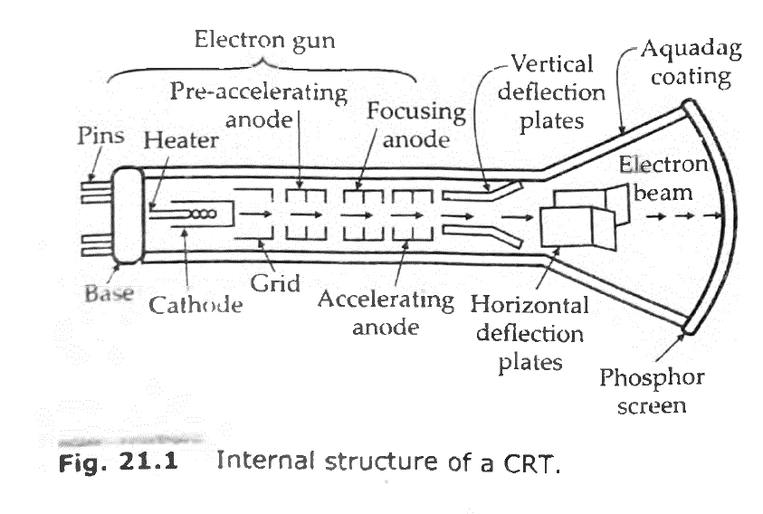

Slide 9
After leaving the electron gun, the electron beam passes through two pairs of "Electrostatic deflection plates".
Voltages applied to these plates deflect the beam. Voltages applied to one pair of plates move the beam vertically up and down and the voltages applied to the other pair of plates move the beam horizontally form one side to another.
These two movements i.e., horizontal and vertical are independent of each other and thus the beam may be positioned anywhere on the screen.
The working parts of a CRT are enclosed in an evacuated glass envelope so that the emitted electrons are able to move about freely from one end of the tube to the other.

Slide 10
Vertical (Y) deflection system
The signals to be examined are usually applied to the vertical or Y deflection plates through an input attenuator and a number of amplifier stages.
Vertical amplifier is required because the signals are not strong enough to produce measurable deflection on the CRT screen.
The amplifier response must be wide enough to pass faithfully the entire band of frequencies to be measured.
When high voltage signals are to be examined, they must be attenuated to bring them within the range of vertical amplifiers.
The vertical amplifier output is also applied to the synchronizing amplifier through the synchronizer selector switch in the internal position.
This permits the horizontal sweep circuit to be triggered by the signal being investigated.

Slide 11
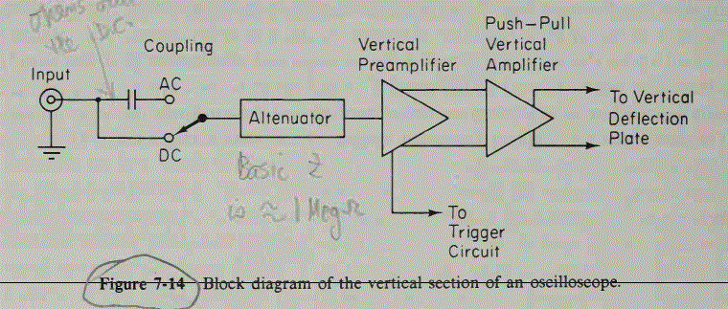

Slide 12
Horizontal (X) deflection system.
The horizontal (X) deflection plates are fed by a sweep voltage that provides a time base.
The horizontal plates are supplied through an amplifier, but they can be fed directly when voltages are of sufficient magnitude.
When external signals are to be applied to the horizontal deflection system, they can also be fed through the horizontal amplifier, via the sweep selector switch in the external position.
When the sweep selector switch is in the internal position, the horizontal amplifier receives an input from the saw tooth sweep generator which is triggered by the synchronizing amplifier.

Slide 13
DELAY LINE
Function of the Delay Line
All electronic circuitry in the oscilloscope (attenuators, amplifiers, pulse shapers, generators, and indeed the circuit wiring itself) causes a certain amount of time delay in the transmission of signal voltages to the deflection plates.
Almost all of this delay is created in circuits that switch, shape, or generate.
Comparing the vertical and horizontal deflection circuits in the oscilloscope block diagram of Fig. 7-22, we observe that the horizontal signal (time base, or sweep voltage) is initiated, or triggered, by a portion of the output signal applied to the vertical CRT plates.
Signal processing in the horizontal channel consists of generating and shaping a trigger pulse (trigger pickoff) that starts the sweep generator, whose output is fed to the horizontal amplifier and then to the horizontal deflection plates.
This whole process takes time: on the order of 80 ns or so. To allow the operator to observe the leading edge of the signal waveform, the signal drive for the vertical CRT plates must therefore be delayed by at least the same amount of time.
This is the function of the vertical delay line. We observe that in Fig. 7-22 a 200-ns delay line has been added to the vertical channel, so that the signal voltage to the CRT plates is delayed by 200 ns, and the horizontal sweep is started prior to the vertical deflection. Although the

Slide 14
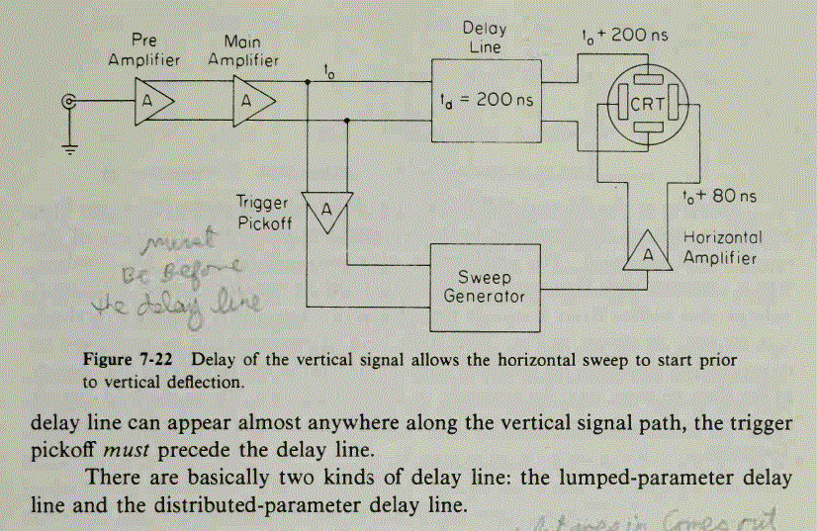

Slide 15
OSCILLOSCOPE PROBES AND TRANSDUCERS
The primary function of the oscilloscope is to display voltage as a function of time, and the description of the attenuator probe was covered in Sec. 7-5.
There are other probes and transducers that can make the oscilloscope more versatile.
Other than the 10-to-l probe, there are also other attenuation ratios such as a 1 to 1, which is nothing more than a cable with a probe tip and no other components.
One useful probe is the active probe, which achieves a lower capacitance without the attenuation associated with the 10-to-l probe.
The final special transducer, since it is more than just a probe, is the current probe, which allows the oscilloscope to measure current without breaking the circuit under test.
A schematic of the active probe is shown in Fig. 7-33. In this example a field effect transistor is used as the active element to amplify the input signal.

Slide 16
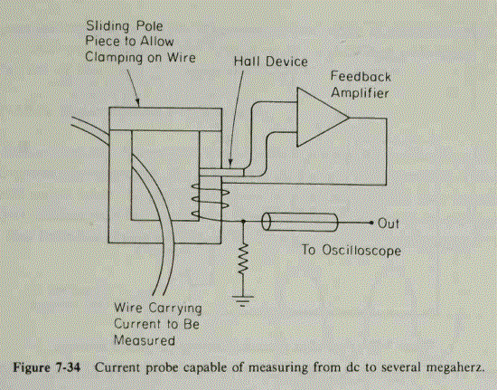

Slide 17
One very valuable probe is the current probe.
This device can be clamped around a wire carrying an electrical current without any physical contact to the probe, allowing the oscilloscope to be used to measure the magnitude of the current with a frequency response from dc to 50 MHz.
The current sensor consists of two parts, a conventional transformer for transforming alternating current to voltage, and a Hall effect device for converting direct current to a
voltage, as shown in Fig. 7-34.
A magnetic core with a removable piece is used as the coupling element for the current probe.
The wire carrying the current to be measured is inserted in the center of the magnetic core and is similar to a primary of a transformer.
Alternating current in the wire will induce voltage in the secondary winding by conventional transformer action.
Only alternating current will introduce a voltage in the secondary.
Any direct currents will not appear at the current transformer secondary.
In addition, the direct current passing through the wire will cause the magnetic flux in the core to increase and will affect the permeability of the material used for the core.
This is undesirable, especially if the current in the wire should cause the core material to become saturated.
If this should happen, the transformer action of the current transformer will become severely affected and provide inaccurate measurements.

Slide 18
To provide a frequency response to zero or dc, a Hall effect sensor is also included in the current probe.
The Hall effect occurs in many semiconductors as shown in Fig. 7-35. Current flow through the semiconductor shown is by the drift of electrons through the bulk material.
The drift current occurs when an electric field is applied to the semiconductor material that causes the electrons to enter at the negative terminal and drift to the positive terminal. Generally, the motion is along a straight line, and if the potential were measured between points A and B, the potential difference would be zero.
If the semiconductor material were subjected to a magnetic field, the direction of which is perpendicular to the motion of the drift electrons, the moving electrons would experience a force that would cause the paths of the electrons in the semiconductor material to move to one side, as shown in Fig. 7-36.
Because the distribution of electrons is greater on one side than the other, there would exist a potential between the two sides, A and B. The Hall effect sensor is included in the magnetic core structure of the current probe.
A feedback system is arranged with an amplifier such that any magnetic field present in the Hall sensor will cause current to be induced into the secondary windings of the current transformer to counteract the magnetic field introduced by the wire being measured.
Thus the Hall effect sensor assures that the static magnetic flux in the core is exactly zero. The amount of current required to counteract the magnetic field induced by the wire being measured is directly proportional to the magnitude and direction of the current passing through the wire being measured.
Because the current required to counteract the static magnetic flux in the core also passes through the terminating resistor for the secondary of the current transformer, this applied counteracting current appears as a dc voltage at the oscilloscope and represents the magnitude of the current in the wire.

Slide 19
Probes
The probe performs the very important function of connecting the test circuit to the oscilloscope without altering, loading, or otherwise disturbing the test circuit.
The probes are of three different types :
(i) direct reading probe,
(ii) circuit isolation probe, and
(iii) detector probe.
Direct reading probe.
This probe is simplest of all the probes and uses a shielded co-axial cable.
It avoids stray pick-ups which may create problems when low level signals are being measured.
It is usually used for low frequency or low impedance circuits. However, in using the shielded probe, the shunt capacitance of the probe and cable is added to the input impedance and capacity of the scope and acts to lower the response of the oscilloscope to high impedance and high frequency circuits.

Slide 20
Isolation probe.
Isolation probe is used in order to avoid the undesirable circuit loading effects of the shielded probe.
The isolation of the probe, which is used along with a capacitive voltage divider, decreases the input capacitance and increases the input resistance of the oscilloscope.
This way the loading effects are drastically reduced.
Detector probe.
When analyzing the response to modulated signals used in communication equipment like AM, FM and TV receivers, the detector probe functions to separate the low frequency modulation component from the high frequency carrier.
The amplitude of the modulator carrier (which is proportional to the response of the receiver to the much high frequency carrier signal) is displayed on the oscilloscope by rectifying and bypassing action.
This permits an oscilloscope capable of audio-frequency response to perform signal tracing tests on communication signals in the range of hundreds of MHz, a range, which is beyond the capabilities of all oscilloscopes except the highly specialized ones.

Slide 21
Specification of an Oscilloscope
1. Oscilloscope bandwidth specification
One important oscilloscope specification is related to the frequency or speed of the waveforms that can be measured. This is determined by the bandwidth of the oscilloscope and it is found that the capability of the oscilloscope to accurately display the waveform falls off with increasing frequency.
2. Number of channels
Oscilloscopes come with a variety of numbers of channels. Very basic ones may only have a single channel, but this will still enable it to perform many tasks as a single channel is what is used for the majority of measurements and investigations.
However, many scopes will have two or four channels. A very few may have a higher number, but this is not very common and adds considerably to the cost and it may detract from some performance areas.
3. Screen size
Oscilloscope display screens have improved immeasurably over the last few years. Screen sizes have increased significantly and the definition is very much better.
4. Vertical DC gain accuracy
It is important when measuring the amplitude of signals, to know the accuracy of the measurement that is being made.
5. Vertical channel resolution
Digital oscilloscopes need to convert the incoming analogue signal into a digital signal. The vertical channel resolution determines the "granularity" of the signal.
The vertical channel resolution is dependent upon the digital to analogue converter in the scope. For example, eight bits provides 256 digitizing levels (2 to the 8th power), and with a 10bit resolution this gives 1024 different levels.

Slide 22
6. Rise time specification
Another important oscilloscope specification which needs to be accommodated is the rise time of the oscilloscope. This is a particularly important specification for any digital circuits where the edges on square waves and pulses are often of great importance. The oscilloscope must have a sufficiently fast rise time to capture the rapid transitions accurately, otherwise important information may not be displayed and the results could be misleading.
The rise time of the oscilloscope is defined as the time it takes for the image to rise from 10% to 90% of the final value.
7. Oscilloscope sample rate
With the proportion of digital oscilloscopes rising, the sample rate oscilloscope specification is becoming a more widespread and important specification. The sample rate is specified in samples per second (S/s).
The faster the oscilloscope samples the waveform, the greater the resolution of the detail on the waveform and with greater sample rates the less the likelihood that any critical information will be lost.
8. Memory depth
This is the memory for storing signals. The greater the memory depth the more signal it is possible to capture at the highest sample rate.

Slide 23
Physical scope specifications
Apart from purely electrical specifications, some of the physical ones are also important as they can affect the usability as much.
There will be several scope mechanical-type specifications that will be included int he data-sheet.
9. Size: The physical size that the scope occupies will have a major bearing on how it can be used. Fortunately today the size of oscilloscopes is very much less than it was before the turn of the century. Gone are the thermionic cathode ray tubes that were used. These needed to be very long, and many scopes were up to a half or three quarters of a metre in depth and as a result they occupied a lot of bench space. Today's scopes are much smaller as they use more up to date technology for the displays.
10. Noise : It was surprising when someone mentioned that noise could be a significant issue for an oscilloscope. However some larger scopes may have fans that are activated to keep them cool. The fan noise can be loud on some occasions and it may be distracting to work next to. It is worth considering the specification for the noise level, when buying an oscilloscope or selecting one in case it could be an issue.

Slide 24
Oscilloscope measurement Techniques
The oscilloscope is a very versatile instrument whose use is limited only by the skill of the operator.
Although there are more sophisticated instruments, most oscillographic measurements are made with a dual-trace oscilloscope with delay sweep capabilities.
Therefore, the discussion of oscilloscope techniques will assume the use of this class of instrument.

Slide 25
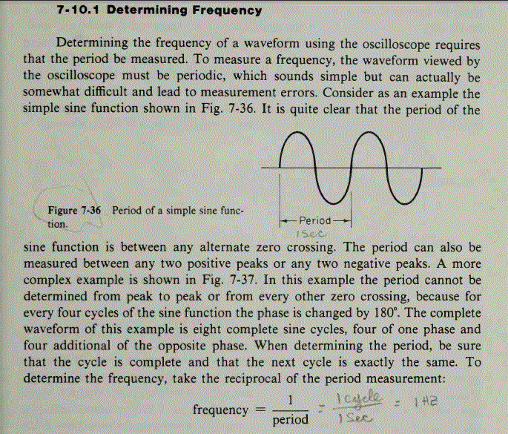

Slide 26
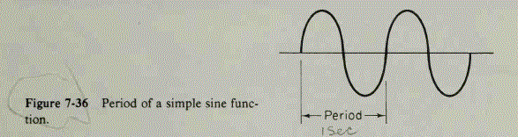
1. Determining Frequency
Determining the frequency of a waveform using the oscilloscope requires that the period be measured. To measure a frequency, the waveform viewed by the oscilloscope must be periodic, which sounds simple but can actually be somewhat difficult and lead to measurement errors. Consider as an example the simple sine function shown in Fig. 7-36. It is quite clear that the period of the sine function is between any alternate zero crossing. The period can also be measured between any two positive peaks or any two negative peaks. A more complex example is shown in Fig. 7-37. In this example the period cannot be determined from peak to peak or from every other zero crossing, because for every four cycles of the sine function the phase is changed by 180°. The complete waveform of this example is eight complete sine cycles, four of one phase and four additional of the opposite phase. When determining the period, be sure that the cycle is complete and that the next cycle is exactly the same. To the frequency, take the reciprocal of the period measurement:
frequency = 1/Time period

Slide 27
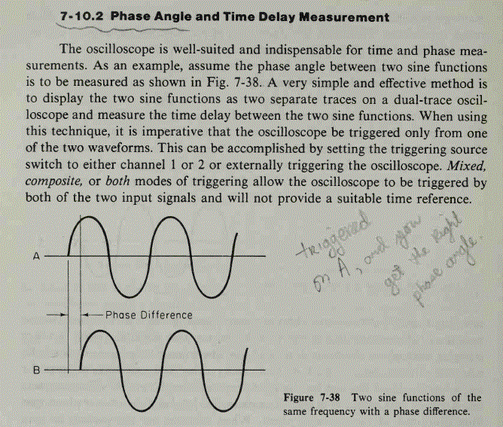

Slide 28
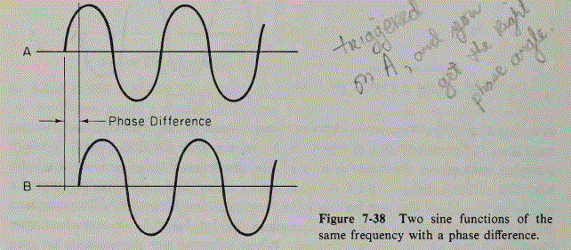
7- 1 0.2 Phase Angle and Time Delay Measurement
The oscilloscope is well-suited and indispensable for time and phase measurements. As an example, assume the phase angle between two sine functions is to be measured as shown in Fig. 7-38. A very simple and effective method is to display the two sine functions as two separate traces on a dual-trace oscilloscope and measure the time delay between the two sine functions. When using this technique, it is imperative that the oscilloscope be triggered only from one of the two waveforms. This can be accomplished by setting the triggering source switch to either channel 1 or 2 or externally triggering the oscilloscope. Mixed, composite, or both modes of triggering allow the oscilloscope to be triggered by both of the two input signals and will not provide a suitable time reference.

Slide 29
7-10.3 Determining Signal Origins
In many electronic systems, failures will involve signals appearing where they do not belong. A simple example of such a situation is a power supply where ripple voltages appear on the supply voltages.
A source of this ripple voltage could be from the 60-Hz supply, or it could also be injected from a malfunctioning circuit. One method of determining the source of such extraneous signals is to trigger the oscilloscope from a suspected source and view the extraneous signal with the oscilloscope.
If the triggering signal of the oscilloscope is the source of the offending signal, the viewed waveform will be stationary, but if the source is elsewhere, the viewed waveform will move in time.
Returning to the power supply example, if the oscilloscope were triggered from the 60-Hz line, and many oscilloscopes have a switch for this purpose, the offending ripple, if it were due to the 60-Hz line, would be stationary; if it were developed elsewhere, it would move in time.
Sixty-hertz pickup by electronics circuits is very common, and this technique allows quick verification of the source of the undesired signal.

Slide 30
7-10.4 Determining Modulation Characteristics
The oscilloscope can be used to measure the amount of amplitude modulation applied to a carrier for adjusting and troubleshooting amplitude-modulated transmitters, both full carrier and single sideband.
To display the carrier, the oscilloscope must be capable of covering the carrier frequency of the transmitter. he horizontal sweep, on the other hand, only has to cover the modulation frequencies, which in most cases is the voice-frequency band from 300 Hz to 3 kHz.

Slide 31
7-11 SPECIAL OSCILLOSCOPES
7-11.1 Storage Oscilloscope
In the conventional CRT the persistence of the phosphor ranges from a few milliseconds to several seconds, so that an event that occurs only once will disappear from the screen after a relatively short period of time.
A storage CRT can retain the display much longer, up to several hours after the image was first written on the phosphor.
This retention feature can also be useful when displaying the waveform of a very low-frequency signal.
In the conventional (non-storage) oscilloscope, the start of such a display would fade before the end is written.
Storage CRTs can be classified as bistable tubes and halftone tubes. The bistable tube will either store or not store an event and produces only one level of image brightness.
The halftone tube can retain an image for varying lengths of time (variable persistence) and at different levels of image brightness.
Both the bistable and halftone tubes use the phenomenon of secondary electron emission to build up and store electrostatic charges on the surface of an insulated target.

Slide 32
Storage oscilloscope
An instrument that is used to measure fast nonrepetitive signals. It does this by capturing the signal on demand and continuing to display it until reset.
This can be achieved in two ways: a digital storage oscilloscope samples the incoming signal, stores these samples, and displays them; other storage oscilloscopes use a special storage cathode-ray tube that retains the image by mapping it as a charge pattern on an electrode behind the screen; the pattern then modulates the electron beam to give a picture of the captured signal.

Slide 33
7-11.2 Sampling Oscilloscope
When the frequency of the vertical deflection signal increases, the writing speed of the electron beam increases.
The immediate result of higher writing speed is a reduction in image intensity on the CRT screen.
In order to obtain sufficient image brilliance, the electron beam must be accelerated to a higher velocity so that more kinetic energy is available for transfer to the screen and normal image brightness is maintained.
An increase in electron beam velocity is easily achieved by raising the voltage on the accelerating anodes.
A beam with higher velocity also needs a greater deflection potential to maintain the deflection sensitivity.
This immediately places higher demands on the vertical amplifier.
The sampling oscilloscope uses a different approach to improve highfrequency performance.
In the sampling oscilloscope the input waveform is reconstructed from many samples taken during recurrent cycles of the input waveform and so circumvents the bandwidth limitations of conventional CRTsand amplifiers.

Slide 34
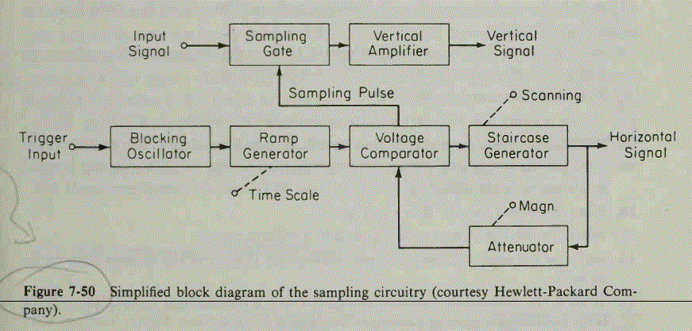

Slide 35
A simplified block diagram of the sampling circuitry is given in Fig. 7-50.
The input waveform, which must be repetitive, is applied to the sampling gate.
Sampling pulses momentarily bias the diodes of the balanced sampling gate in the forward direction, thereby briefly connecting the gate input capacitance to the test point.
These capacitances are slightly charged toward the voltage level of the input circuit.
The capacitor voltage is amplified by the vertical amplifier and applied to the vertical deflection plates.
Since the sampling must be synchronized with the input signal frequency, the signal is delayed in the vertical amplifier, allowing the sweep triggering to be done by the input signal.
When a trigger pulse is received, the avalanche blocking oscillator (so called because it uses avalanche transistors) starts an exactly linear ramp voltage, which is applied to a voltage comparator.
The voltage comparator compares the ramp voltage to the output voltage of a staircase generator. When the two voltages are equal in amplitude, the staircase generator is allowed to advance one step and simultaneously a sampling pulse is applied to the sampling gate.
At this moment, a sample of the input voltage is taken, amplified, and applied to the vertical deflection plates.

Slide 36
Recorder
A recorder is a measuring instrument that displays a time-varying signal in a form easy to examine and re-examine, even after the original signal has ceased to exist.
Recording preserves the experimental data in a manageable and usable form.
Two types:
  Analog Recorder
  Digital Recorder

Slide 37
Recorder
Analog Recorder
Graphic Recorder Oscillographic Recorder Magnetic Tape Recorder
Strip Chart Recorder X-Y Recorder Circular Chart Recorder

Slide 38
Strip Chart Recorder
It records one or more variables with respect to time. It is a X-t recorder.
A strip chart recorder consists of:
  A long roll of graph paper moving vertically.
  A system for driving the paper at some selected speed.
  A stylus for making marks on the graph paper.
  A stylus driving system which moves the stylus in exact replica of quantity being measured.

Slide 39
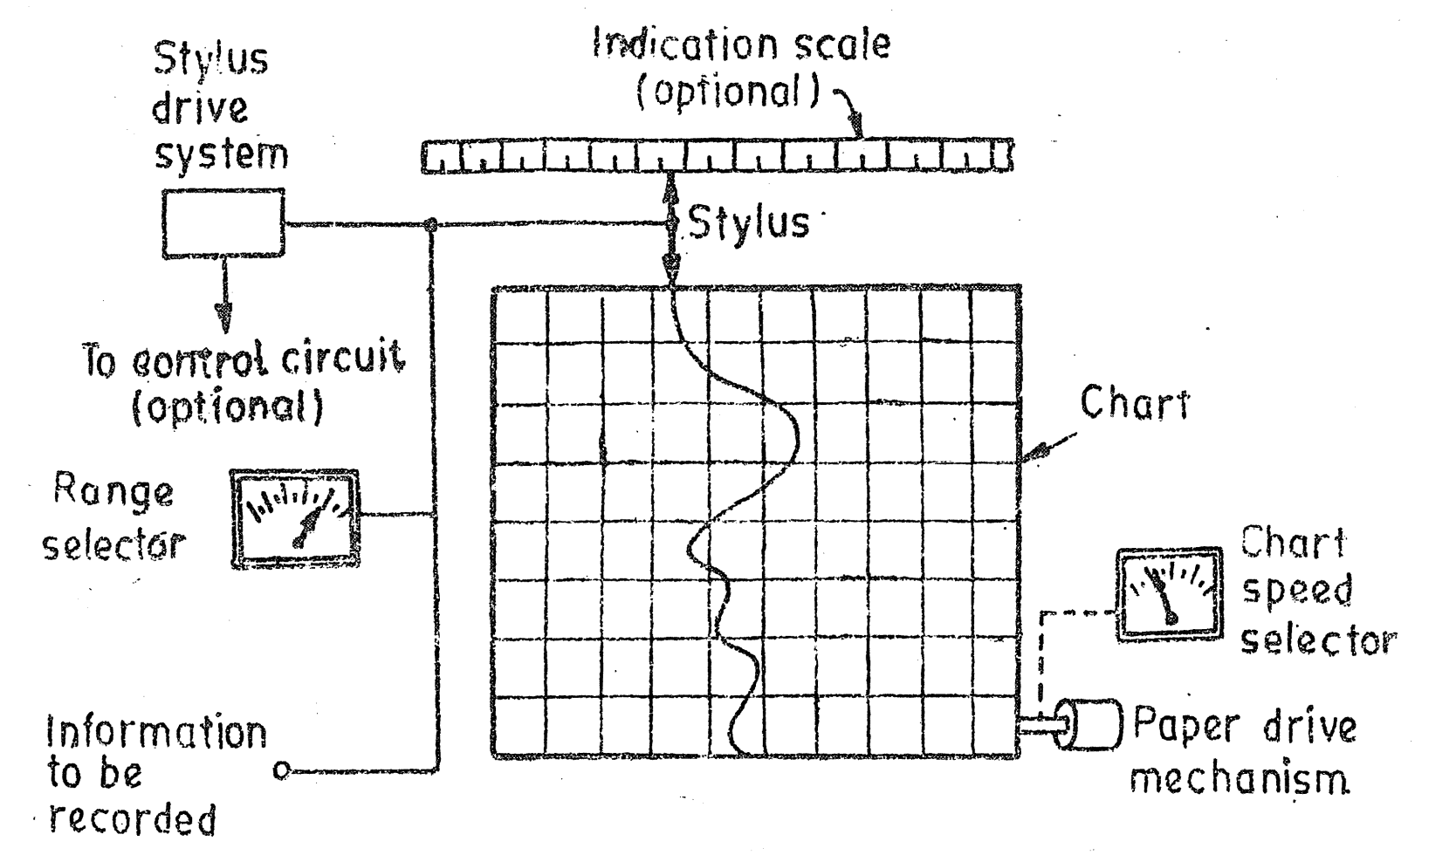
Strip Chart Recorder
  A range selector to fit the input within the acceptable level.
The strip chart recorder is as:

Slide 40
Strip Chart Recorder
3. Marking Mechanism:
  Marking with ink filled stylus
  Marking with heated stylus
  Chopped bar (impart printing)
  Electric stylus marking
  Optical marking
  Electrostatic stylus

Slide 41
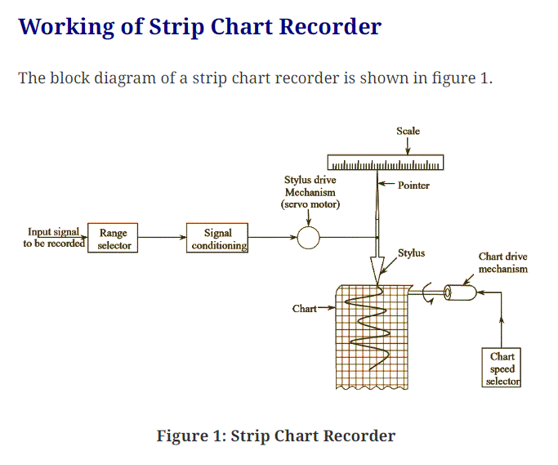

Slide 42
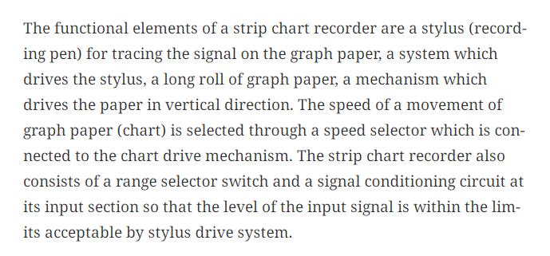

Slide 43
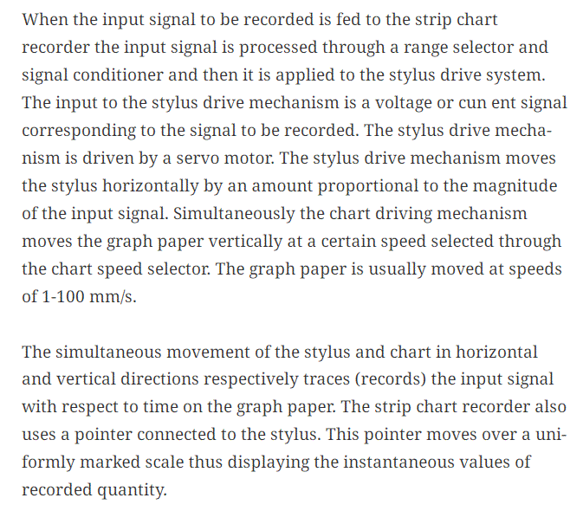

Slide 44
X-Y Recorder
X-Y recorders or X-Y plotters accept two inputs and create a chart or graph of one input versus the other.
They are commonly used to determine the relationship between the two inputs.
With the help of these recorders and appropriate transducers, a physical quantity may be plotted against another physical quantity.

Slide 45
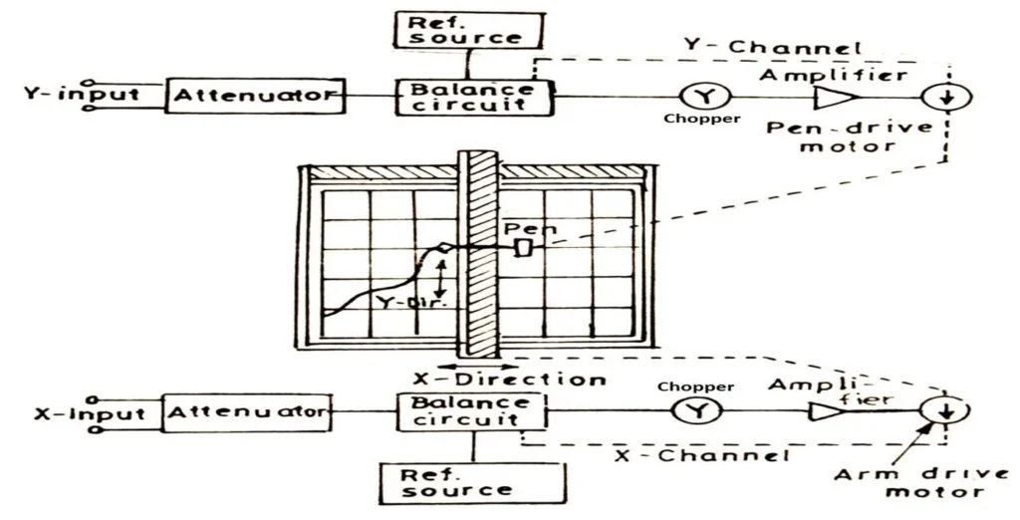
X-Y Recorder

Slide 46
Working of X-Y Recorder
A signal enters in each of the two channels.
Attenuators are used to bring the input signals to the levels (full scale range: 0.5 mV) acceptable by the recorder.
As shown in figure, error signals (the difference between the input signals and reference voltage) are fed to a chopper which convert dc signals to ac signals.
The signals are then amplified in order to actuate servomotors which are used to balance the system and hold it in balance as the value of the quantity being recorded changes.

Slide 47
Working of X-Y Recorder
The action described above takes place in both the axes simultaneously. Thus, we get a record of one variable w.r.t. another.
An X-Y recorder may have a sensitivity of 10 µV/mm, a speed of 1.5 m/s, a frequency response about 6 Hz for both axes, chart size of 250 x 180 mm, and accuracy of about ± 0.3%.

Slide 48
Applications Of X-Y Recorder
Speed-torque characteristics of motors
Plotting of characteristics of vacuum tubes, Zener diodes, rectifiers, transistors etc.
Pressure-volume diagrams for LC engines
Pressure-flow studies for lungs
Lift drag wind tunnel tests
Regulation curve (output versus input voltage) of power supplies
Electrical characteristics of materials such as resistance versus temperature
Plotting stress versus strain curves, hysteresis curves etc.

Slide 49
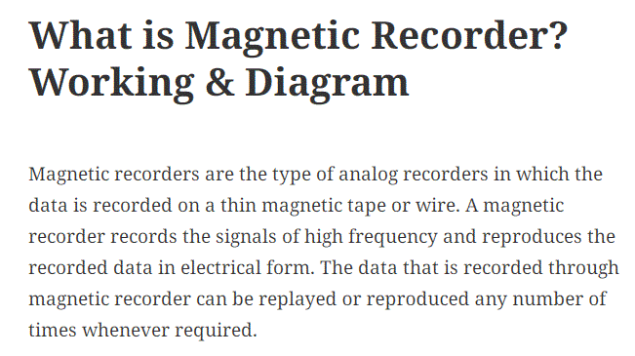

Slide 50
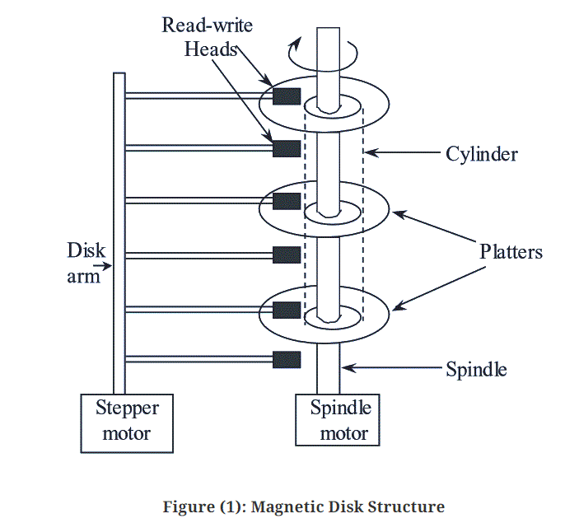

Slide 51
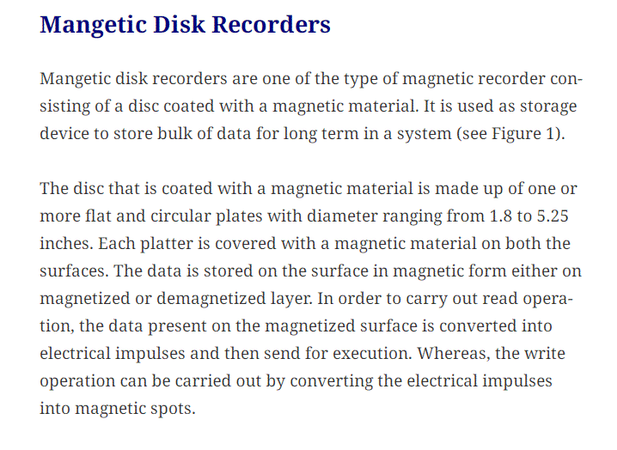

Slide 52
Magnetic Tape Recorder
The major advantage of using a magnetic tape recorder is that once the data is recorded, it can be replayed an almost indefinite number of times.
The recording period may vary from a few minutes to several days. Speed translation of the data captured can be provided, i.e. fast data can be slowed down and slow data speeded up by using different record and reproduce speeds.
Magnetic tape recorder have a good response to high frequency, i.e. they can be used to record high frequency signals.

Slide 53
Magnetic Tape Recorder
Basic components:
1. Magnetic Tape
2. Recording Head
3. Reproducing Head
4. Tape transport mechanism
5. Conditioning devices

Slide 54
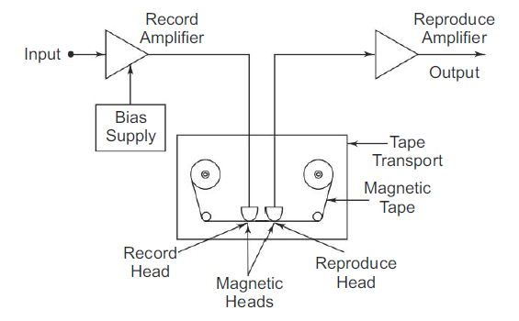
Magnetic Tape Recorder

Slide 55
Magnetic Tape:
  It is made of a thin sheet of tough, dimensionally stable plastic, one side of which is coated with a magnetic material (iron oxide).
Recording Head:
  It is s device that impresses residual pattern upon magnetic tape in response to an amplified i/p signal.
  It consists of core of high permeability material with a coil and fine air gap (10µm).
  The air gap is shunted by passing the magnetic tape and coil current creates flux to bridge the air gap.
  The flux in air gap passes thru the tape and magnetizes iron oxide of the tape.

Slide 56
Reproduce Head:
  Similar to record head.
  Magnetic tape is passed over a reproduce head thereby resulting an o/p voltage proportional to the magnetic flux in the tape across the coil of the reproduce head.
Tape Transport Mechanism:
  It moves the tape along the record head or reproduce head at constant speed without any strain, distortion and tear.
  Tape should be in contact with head.
  Fast winding and rewinding are provided.

Slide 57
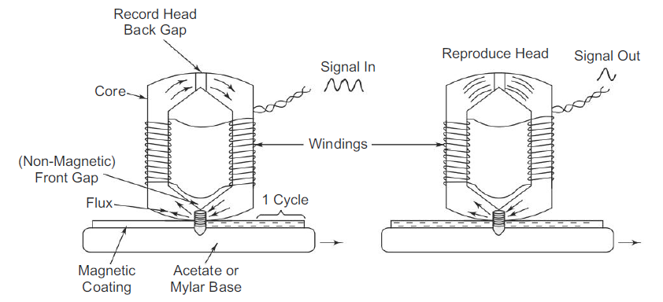
Record and Reproduce Head

Slide 58
Advantages of magnetic tape recorder
They have wide frequency range DC to several MHz.
They have low distortion.
The signal can be reproduced whenever required as magnitude of electrical signal is stored in magnetic memory.
The recorded signal is immediately available. The recorded signal can be played back or reproduced as many times as required without the loss of signal.
The tape can be erased and reused to record a new set of data.

Slide 59
Disc recorders
A compact disc recorder is a device that can be used to put information on a recordable compact disc.
This may include data in the form of computer files, or video or audio clips.
The most common place to find a compact disc recorder is as part of a computer package, but there are standalone models as well that can be connected to a video or audio source.
Depending on the file format, the recording from a compact disc recorder may be readable by a number of different devices.
Common uses include CD readers, such as those on computers, or CD players, normally used in sound systems.
These are found in a variety of settings and are mainly meant for the playing of audio information.
In some cases, some CD players may not be able to read recordings from certain types of recorders.
Therefore, it is important that a compact disc recorder write information in a format compatible with the intended player.

Slide 60
In addition to being able to write information on a compact disc recorder, the device is also usually capable of reading the information as well. Thus, it is a dual use tool.
However, the speed it reads and the speed it records may be quite different. In addition to being able to read CDs, some compact disc recorders may also be able to read DVDs.
In fact, as technology continues to evolve, most compact disc recorders now also function as DVD players and recorders.
In some cases, this may be a more expensive option, but it often comes standard. The computer is able to detect whether the disc is a recordable CD or DVD, and automatically change its format to fit the media type.

Slide 61
Direct Recording
The linearity between residual flux and recording current is very poor.
Hence, to obtain linearity in direct recording, FM is used (i.e. a high frequency ac is added).
In all systems, the signal is reproduced by passing the magnetised tape over a magnetic head similar to the recording head.
The magnetisation of the particles on the tape induces a varying flux in the reproducing head and a voltage is induced in the coil, proportional to the rate of change of flux.

Slide 62
During reproduction:
The tape is passed over a reproducing head resulting in an o/p voltage proportional to the magnetic flux in the tape, across the coil of reproducing head.
Since the o/p voltage depends on the rate of change of flux . If dc at i/p had produced constant tape magnetization, the reproducing head would have given zero o/p voltage. So, the direct recording process can be used with varying i/p signal with about 50Hz.
Since the reproduce head has differentiating characteristics, the reproducing amplifier must have an integrating characteristics so that the system o/p is proportional to i/p.

Slide 63
Merits of Direct Recording
This recording process has a wide frequency response, ranging from 50 Hz – 2 MHz for a tape speed of 3.05 m/s. It provides the greatest bandwidth obtainable for a given recorder.
It requires simple electronic circuits.
It has a good dynamic response and takes overloads without increase in distortion.
It is used to record signals where information is contained in the relation between frequency and amplitude, such as the spectrum analysis of noise.
It can be used for recording voice signals.

Slide 64
Demerits of Direct Recording
The direct recording process is characterised by some amplitude instability caused by random surface inhomogeneities coating. Some portion may not be perfectly recorded owing to dirt or poor manufacture.
This recorder is only used when maximum bandwidth is required.

Slide 65
Null Type Recorder:
These Null Type Recorder Working Principle of self-balancing or null conditions. When an input is given to the measuring circuit of the recorder from a sensor or transducer, it upsets the balance of the measuring circuit, producing an error voltage which operates some other device, which in turn restores the balance or brings the system to null conditions.
The magnitude of the error signal indicates the amount of movement of this balance restoring device and the direction of the movement indicates the direction of the quantity being measured.
The different types of Null Type Recorder are as follows:
1. Potentiometric recorders
2. Bridge recorders
3. LVDT recorders (Linear Variable Differential Transformer)

Slide 66
1. Potentiometric Recorders:
The basic disadvantage of a galvanometer type recorder is that is has a low input impedance and a limited sensitivity. This disadvantage can be overcome by using an amplifier between the input terminals and the display or indicating instruments.
This amplifier provides a high input impedance and improved sensitivity at the cost of low accuracy. To improve the accuracy of the instrument, the input signal is compared with a reference voltage using a potentiometer circuit.
The self-balancing feature is obtained with a servo motor, a motor whose speed and direction of rotation follows the output of an amplifier. In a dc system, this is simply a reversible motor, such as the type that uses a permanent magnet for its field. In the ac system, it takes the form of a two-phase motor.

Slide 67
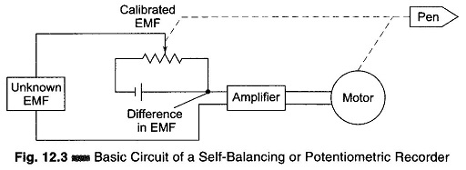
Figure 12.3 is a basic circuit of a potentiometric or self-balancing recorder.

Slide 68
The difference between the input signal and the potentiometer voltage is the error signal. This error signal is amplified and is used to energize the field coil of a dc motor.
In this circuit, instead of obtaining a balance between two opposing voltages by rotating the arm of the voltage divider, an error current is allowed to flow, either clockwise or counter clockwise, depending on which voltage is higher.
This error serves as the input to the electronic detector, and the amplified error is then fed to the balancing motor. This motor is so connected that it turns in a direction that rotates the voltage divider arm (geared) to it in the direction that reduces the error. As the error becomes smaller, the motor slows down and finally stops at the point where the error is zero, thus producing the null balance.
This is achieved by mechanically connecting the wiper/variable arm to the armature of the dc motor. The pen is also mechanically connected to the wiper.
Hence as the wiper moves in a particular direction, the pen also moves in synchronism in the same direction, thereby recording the input waveform. The wiper comes to rest when the unknown signal voltage is balanced against the voltage of the potentiometer. This technique results in graphical recorders having a very high input impedance.

Slide 69
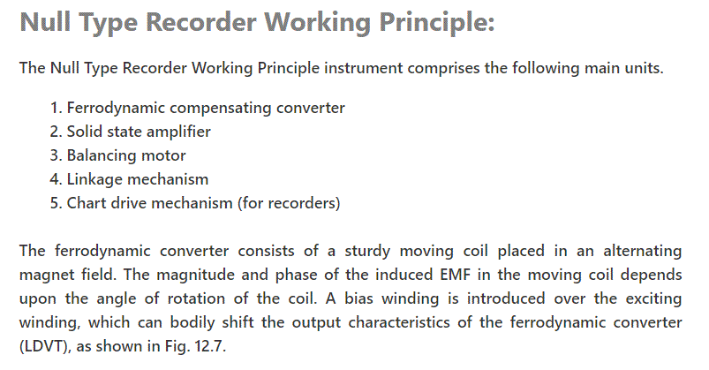

Slide 70
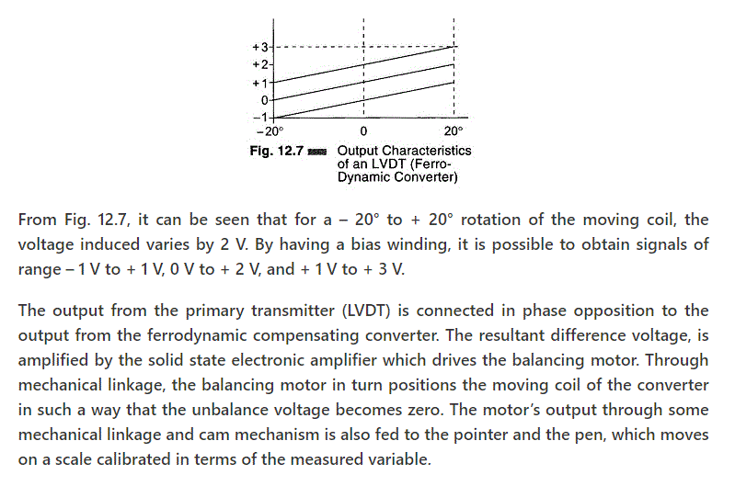

Slide 71
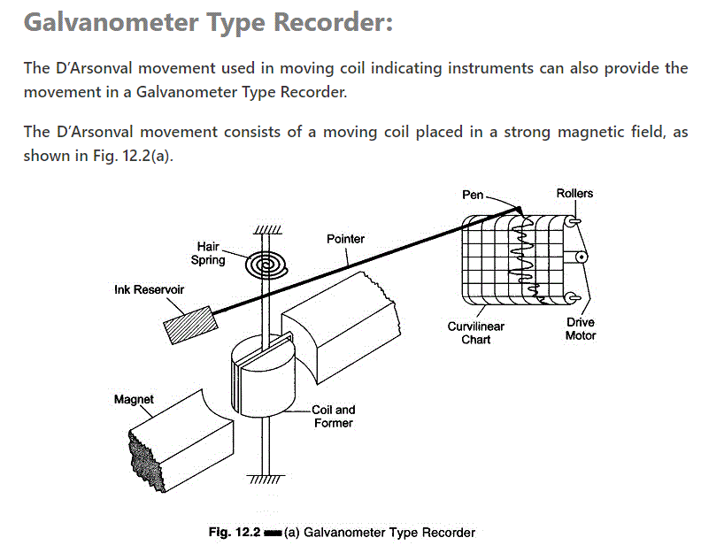

Slide 72
In a galvanometer type recorder, the pointer of the D’Arsonval movement is fitted with a pen-ink (stylus) mechanism.
The pointer deflects when current flows through the moving coil. The deflection of the pointer is directly proportional to the magnitude of the current flowing through the coil.
As the signal current flows through the coil, the magnetic field of the coil varies in intensity in accordance with the signal. The reaction of this field with the field of the permanent magnet causes the coil to change its angular position. As the position of the coil follows the variation of the signal current being recorded, the pen is accordingly deflected across the paper chart.
The paper is pulled from a supply roll by a motor driven transport mechanism. Thus, as the paper moves past the pen and as the pen is deflected, the signal waveform is traced on the paper.
The recording pen is connected to an ink reservoir through a narrow bore tube. Gravity and capillary action establish a flow of ink from the reservoir through the tubing and into the hollow of the pen.

Slide 73
Data Loggers
What is a Data Logger and How Does it Work?
A data logger is an instrument that monitors and records changes in conditions over time. They can be single, stand-alone units or consist of multiple channels. Most stand-alone units are battery-powered, allowing them to record while in transit and for extended periods of time.
How does a data logger work?
Data loggers use a microprocessor, an internal memory for data storage, and a sensor to collect data. They are generally small and battery powered devices. Data loggers can either interface with a computer and use software to view and analyze the collected data or be used as a stand-alone device with a local interface. There are also wireless data loggers available.
The advantage of data loggers is that they can operate independently of a computer, unlike many other types of data acquisition devices. Data loggers are available in various shapes and sizes. The range includes simple economical single channel fixed function loggers to more powerful programmable devices capable of handling hundreds of inputs.

Slide 74
Data logger applications
Data loggers can monitor temperature, humidity, carbon dioxide, pH, pressure, voltage, current, and pulse – making them useful for a number of applications, including to:
Verify temperature and humidity levels of storage and transportation facilities.
Provide building maintenance information on heating, ventilation, and air conditioning operations to assist with energy conversavtion.
Monitor growing conditions in the agricultural industry.
Monitor vaccine storage in a medical facility.
Monitor the temperature of food.
How long can data loggers record?
The recording duration depends on the memory capacity of the data logger and the desired sample rate. To determine the duration, divide the memory capacity (number of samples the device can record) by the sample rate. As an example, assume that a given data logger can store 10,000 samples. If you want to record two samples every minute, the data logger can run for 10,000/2 or 5,000 minutes (about 3.5 days).
How to retrieve data off your data logger ?
Depending on the type of data logger, you can either access the data directly within the data logger and even print it out, connect the data logger to a computer to extract the data, or data can be wirelessly transmitted in real-time to any connected device.

Slide 75
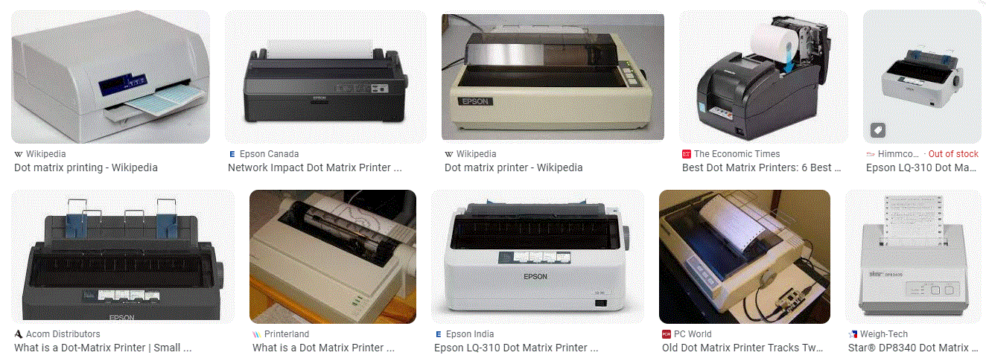
Dot matrix printer

Slide 76
Dot matrix printer
A dot matrix printer is an impact printer that prints using a fixed number of pins or wires.
Typically the pins or wires are arranged in one or several vertical columns.
The pins strike an ink-coated ribbon and force contact between the ribbon and the paper, so that each pin makes a small dot on the paper.
The combination of these dots forms a dot matrix image. They were also known as serial dot matrix printers.
A Dot Matrix Printer or Impact Matrix Printer refers to a type of computer printer with a print head that runs back and forth on the page and prints by impact, striking an ink-soaked cloth ribbon against the paper, much like a typewriter.
Unlike a typewriter or daisy wheel printer, letters are drawn out of a dot matrix, and thus, varied fonts and arbitrary graphics can be produced.

Slide 77
Because the printing involves mechanical pressure, these printers can create carbon copies and carbon less copies.
Each dot is produced by a tiny metal rod, also called a “wire” or “pin”, which is driven forward by the power of a tiny electromagnet or solenoid, either directly or through small levers (pawls).
Facing the ribbon and the paper is a small guide plate pierced with holes to serve as guides for the pins.
The moving portion of the printer is called the print head, and when running the printer as a generic text device it generally prints one line of text at a time.
Most dot matrix printers have a single vertical line of dot making equipment on their print heads; others have a few interleaved rows in order to improve dot density.
These machines can be highly durable, but eventually wear out. Ink invades the guide plate of the print head, causing grit to adhere to it; this grit slowly causes the channels in the guide plate to wear from circles into ovals or slots, providing less and less accurate guidance to the printing wires.

Slide 78
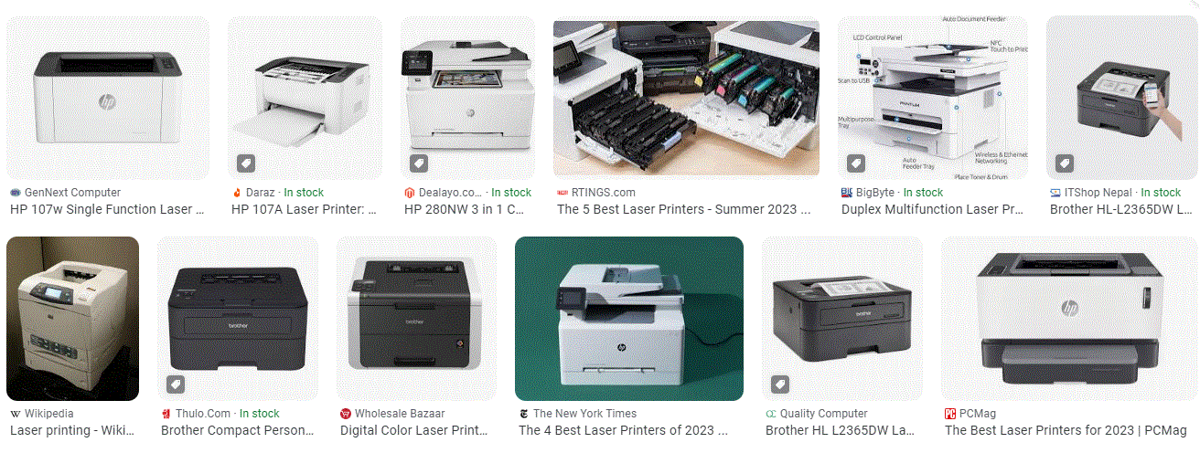
Laser Printer

Slide 79
What is a laser printer?
A laser printer is a popular type of computer printer that uses a non-impact photocopier technology where there are no keys striking the paper.
When a document is sent to the printer, a laser beam "draws" the document on a selenium-coated drum using electrical charges.
The drum is then rolled in toner, a dry powder type of ink that adheres to the charged image on the drum.
The toner is transferred onto a piece of paper and fused to the paper with heat and pressure.
The laser printer was popularized in the mid-1980s as a standalone printer for use with personal computers.
It typically replaced an impact dot matrix printer or a non-impact inkjet printer.
Laser printers are still often connected directly to a single PC, but today many are linked to local area networks (LAN), supporting workgroups or entire departments.
In some cases, a laser printer is used as a multifunction peripheral with printing, scanning, photocopying and fax capabilities.
These devices are known as multifunction printers (MFP).
They usually have MFP or MFC for multifunction center as part of their model numbers.

Slide 80
Laser printers can be used in a home office or a small business office.
Office connectivity is typically via an Ethernet connection.
In a home office or small business, a cable or Wi-Fi are used to connect the printer to computing devices.
Wi-Fi is also used to connect mobile devices to printers for mobile printing.
Laser printers can handle both black and white and color printing, though color laser printers are more expensive than monochrome laser printers.
Typically, laser printers are used for printing whereas newer all-in-one printers can function as a printer, copier, scanner and fax.
Many have user-friendly touch screen displays.

Slide 81
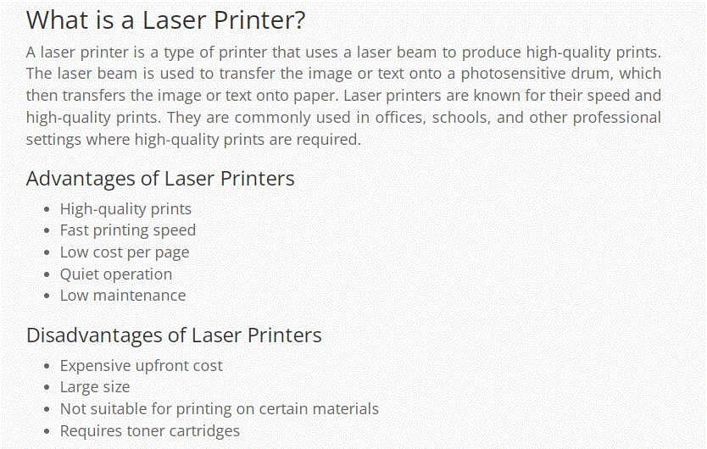

Slide 82


Slide 83
6.4 Indicators and display Devices - Nixie, LED, LCD and seven segment and dot matrix displays.

